Slide 1
QSYS – IADR Overview
Daniel Berkowitz (ATS/ACR)

Slide 2
QSYS Interfaces
MCS
Buildings
CIS
QSYS
ACC NF
MIS
Process & Utilities
ACC PS
MIT
xVAC
Others
SRFCELL
MECH

Slide 3
QSYS – System Breakdown
Cryoplant & Infrastructure
WCS
QRB
WSH
WSH
WSH
WPS
Cryo Backbone
QLM
QVB
QVB
QVE
Cryomodules
QM
QM
QCELL

Slide 4
IADR with “ACC NF”

Slide 5
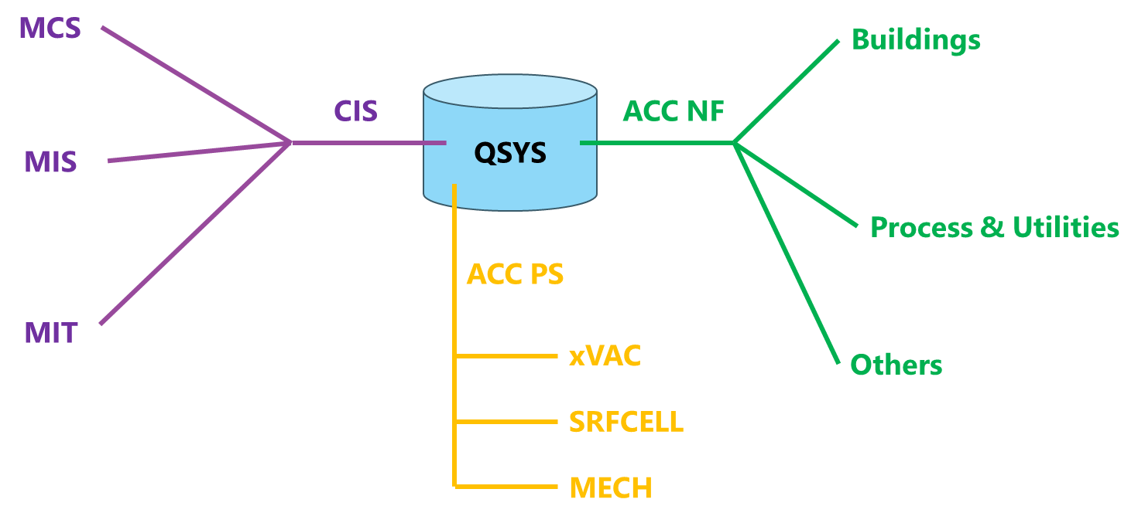
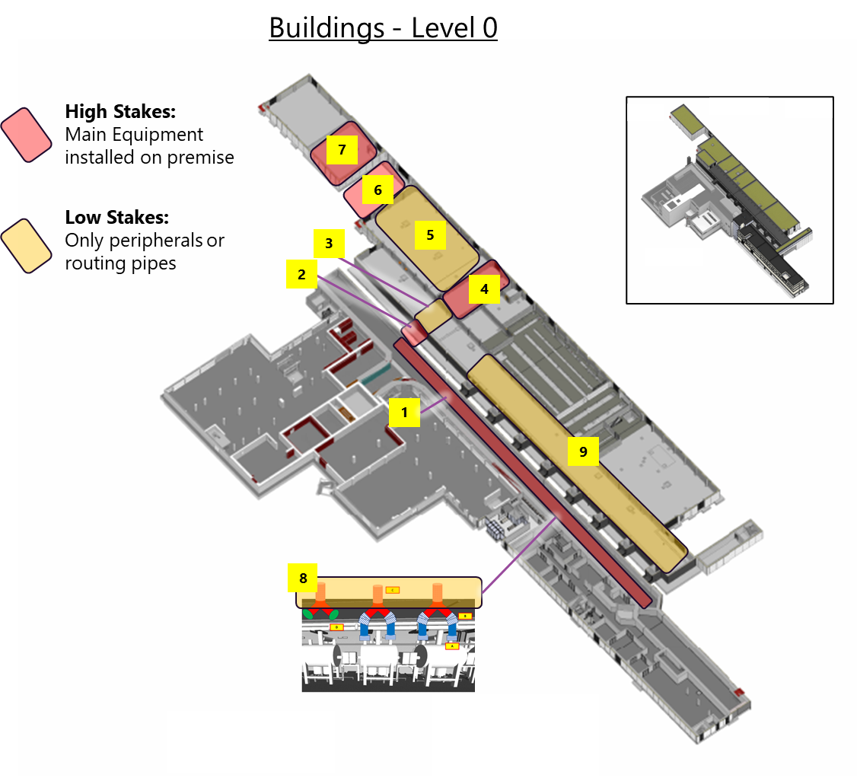
QSYS//ACC NF Interfaces - Buildings
Overview:
“QSYS Buildings Overview.ppt” ALX/46467661
QSYS Buildings Overview.ppt SCK CEN/46467661
#code | Building | IADR Doc | IADR ppt
QB_1 | LTU/interior
QB_2 | LTU/Chicane |  | ALX/90931662
QB_3 | SAB2/RF-Gallery
QB_4 | SAB2/QRB Room
QB_5 | SAB2/Other
QB_6 | SAB1/CCB1
QB_7 | SAB1/CCB2
QB_8 | LTU/vents
QB_9 | SAB2/RF-Gallery

Slide 6
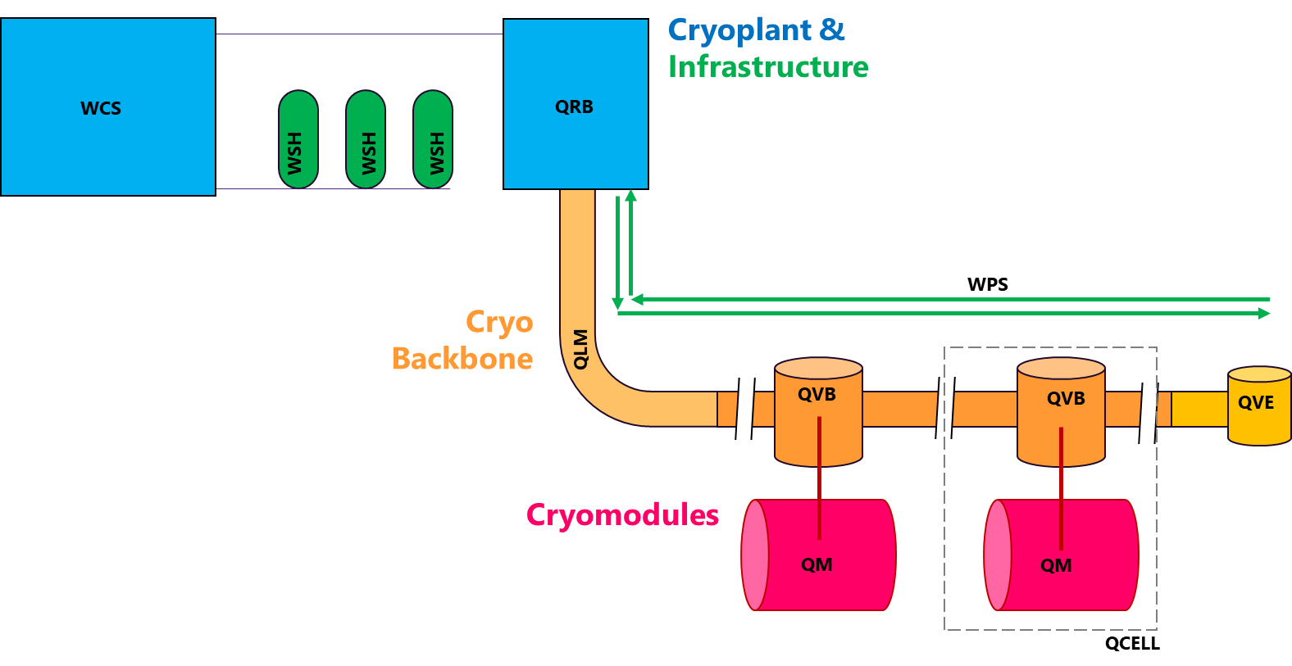
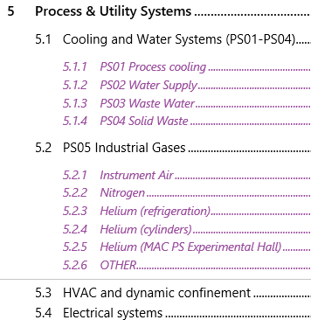
QSYS//ACC NF Interfaces – Process & Utilities
Overview:
“QSYS Process & Utilities Overview.ppt” ALX/90906480
PS02
PS05 Gases
PS05 Gases
water
oil
PS01 water
PS01 water
PS05 Gases
PS03
Power
HVAC
PS05 Gases
Heat recov.
PS03
PS05 Gases
PS05 Gases
water
oil
PS05 Gases
Not in scope:
PS01 & PS03 for RFCELL’s CPLR

Slide 7
QSYS//ACC NF Interfaces – Other
Overview:
“QSYS Other ACC NF Overview.ppt” ALX/xxxx
non-LTU
LTU
Access Control
PS04
PS04

Slide 8
IADR with “CIS”

Slide 9
IADR with “ACC PS”

Slide 10
Copyright © SCK CEN
All property rights and copyright are reserved.
This presentation contains data, information and formats for dedicated use only and may not be communicated, copied, reproduced, distributed or cited without the explicit written permission of SCK CEN.
If this explicit written permission has been obtained, please reference the author, followed by ‘by courtesy of SCK CEN’.
Any infringement to this rule is illegal and entitles to claim damages from the infringer, without prejudice to any other right in case of granting a patent or registration in the field of intellectual property.
SCK CEN
Belgian Nuclear Research Centre
Studiecentrum voor Kernenergie
Centre d'Etude de l'Energie Nucléaire
Foundation of Public Utility
Stichting van Openbaar Nut
Fondation d'Utilité Publique
Registered Office:
Avenue Herrmann-Debrouxlaan 40 - 1160 BRUSSELS - Belgium
Research Centres:
Boeretang 200 - 2400 MOL - Belgium
Chemin du Cyclotron 6 - 1348 Ottignies-Louvain-la-Neuve - Belgium

